Slide 1
Technology Artifact: Classroom Collaboration-Google Docs
Student’s Name
Institution

Slide 2
Introduction
Advanced technologies has changed learning in the 21st century
Technology is informing learning adaptability with the changing environment
One such technology is Google Docs
Google Docs, one of the google apps used in teaching and learning
Word processor available online
Has changed the collaborative learning (Andrew, 2019)
Notes:
Learning in the 21st century has changed because of the advanced technologies that have emerged. According to Andrew (2019), the arrival of new technologies and complex communication platforms has changed the skills required by learners in the current age. According to the author, technologies are constantly evolving and people need to adapt to the changes. As such, integrating these technologies as part of the learning and teaching process ensure that learners are equipped with the latest and updated skills they need to adapt the changing market.

Slide 3
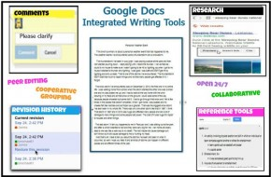
How it will be used
The image below show how Google Docs can be used to improve collaborative learning in classrooms
-Learners and teachers can use Google Docs to share and comment on assignments
-It enables learners to receive immediate feedback on their assignments
-It also provides spellcheck tools that provides learners with writing skills
Notes:
Google Docs is one of the collaborative tools that can be used to improve collaboration between learners and the students in a classroom. The above image has shown the collaborative and integrated tools that Google Docs provides including comment section, reference tool, revision history, and many others. Each of these tools enhances the learners collaboration with the teachers and their peers. Therefore, Google Docs will play a critical role in achieving this goal.

Slide 4
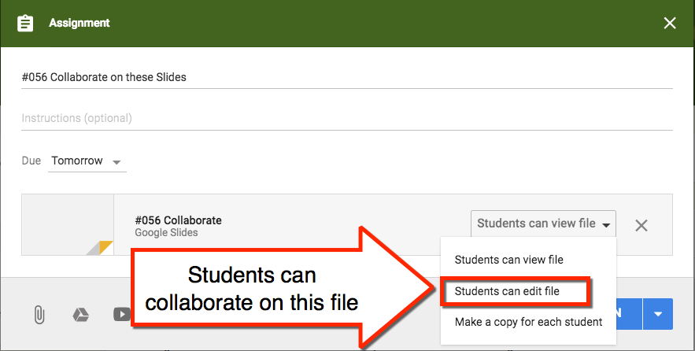
Continuation of How it will be Used
In the next image, Google Docs provides collaborative tool
-The collaborative feature in Google Docs provides learners with opportunity to enhance their writing skills
-Studies have shown that peer feedback in the collaborative writing can have a positive impact on the learners’ writing skills (Ebadi & Rahimi, 2017)
-This collaborative tool allows learners to share and comment on their peer’s work through the “Edit File” tool
-It also enables the teacher to provide timely feedback to the learners
Notes:
Collaborative tools on Google Docs allow learners and teachers to participate in the learning and teaching process effectively. It has wide range of benefits, as explained in the slide, including the ability to support peer’s comment and sharing information. It also enables educators to provide real-time and timely comments to learners. With the current age of online learning, this tool becomes an effective and important classroom tools that teachers and learners can use to interact as if they were in a physical classroom.

Slide 5
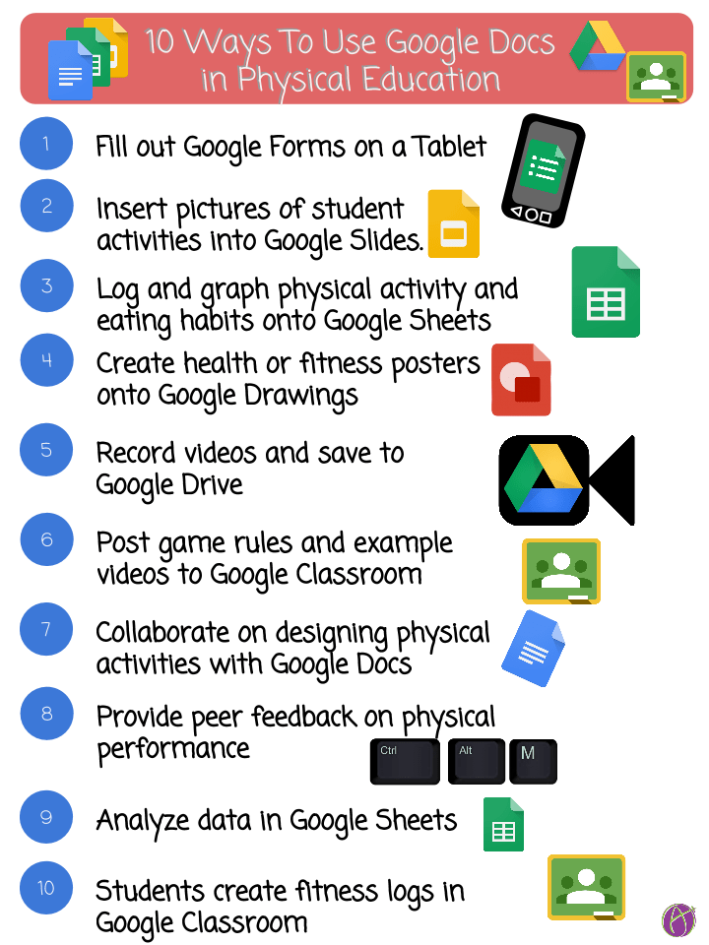
Continuation on Ways to Use Google Docs
The image below shows how students and teachers can use Google Docs tool in a physical education setup.
-Google Docs can be used in a physical education setup
-These ten steps are among the ways that it can be used
-The process is simple and self-manageable
-Learners can collaborate with their teachers to explain what they don’t understand
-Some tools require learners to work with the teacher
This includes; collaborating on designing activities
Notes:
Google Docs tool is a relief to many students and teachers who would like to be updated with the latest knowledge and skills from the world of technology. While this knowledge is essential to students in the 21st century, some learners still have challenges in collaborating or working with these technologies. The above image has provided ten steps that can help learners to integrate and engage with the technology.

Slide 6
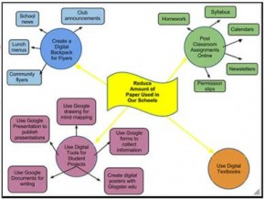
Collaborative Brainstorming
Google Docs has a collaborative brainstorming feature (shown in the image)
-Available in the drawing component
-Suited for collaborative online sessions
-Enables students to work together to create ideas
-Enables them to contribute in the learning process
-Learners can use different tools such as arrow, text, or shapes and even important images to create ideas
-The revision history uses different colors
This makes it easy to see or track changes
Notes:
Google Docs tool has a collaborative brainstorming platform where learners can collaborate with their peers to create ideas. This feature is mainly suited for learners online. It is only supported through the online platform and is most effective for online learning where learners come from different locations. This tool enables learners to work on a project together and also track their revision through the revision history feature that changes the color as shown in the image.

Slide 7
Reasons for Choosing this Technology
Easy access to the database at anytime of the day (24/7)
Can be accessed anywhere as long as the student has access to the internet
It also improves flexibility of learning (Ishtaiwa & Aburezeq, 2015)
It provides free formatting features such as delete and edit-enabling students to revise their work till perfection
It is important in enhancing collaborative learning and teaching
Notes:
I chose this technology because of flexibility, ease of access, and cost-effectiveness. In regards to flexibility, Google Docs tool is one of the most convenient online tools to use. All it requires is access to the internet and the student can access information as well as share what they have with others wherever they are. It is also cost-effective because with this tool, learners will feel that they are in school environment without necessarily travelling to the physical location. Therefore, it is an important tool that learners and teachers can use to improve the learning process.

Slide 8
References
Andrew, M. (2019). Collaborating online with four different google apps: Benefits to learning and usefulness for future work. Journal of Asia TEFL, 16(4), 1268.
Ebadi, S., & Rahimi, M. (2017). Exploring the impact of online peer-editing using Google Docs on EFL learners’ academic writing skills: A mixed methods study. Computer Assisted Language Learning, 30(8), 787-815.
Ishtaiwa, F. F., &Aburezeq, I. M. (2015). The impact of Google Docs on student collaboration: A UAE case study. Learning, Culture and Social Interaction, 7, 85-96.

